Slide 1

Academic Session 2025-26
ODD Semester Jul-Dec 2025
UNIVERSITY INSTITUTE OF ENGINEERING
DEPARTMENT OF AIT-CSE
Bachelor of Engineering (CSE)
AIML\Semester-4
STATISTICAL METHODS FOR AI
(24CST-295)
Unit No. 1 Chapter No. 1 Lecture No.1.1.2
Topic : Dispersion Parameters
Faculty Name and E_Code: Dr Neetu(E17077) Designation: Assistant Professor

Slide 2
Chapter | Course Objectives
1 | To enable students to develop a solid understanding of foundational statistical concepts and techniques relevant to artificial intelligence applications. To impart analytical ability in solving mathematical problems as applied to the respective branches of Engineering. To enable students to gain proficiency in applying statistical methodologies, including regression, classification, clustering, time series analysis, and experimental design, to analyze and model data in AI contexts. To prepare students for real-world AI projects and research endeavors by providing them with a solid foundation in statistical methods, enabling them to contribute effectively to the advancement of AI technologies.
Chapter | Course Outcomes
1 | Student will be able to Remember the foundational concepts of statistics, probability theory, regression methods, and estimation principles essential for AI and data-driven problem-solving.

Slide 3
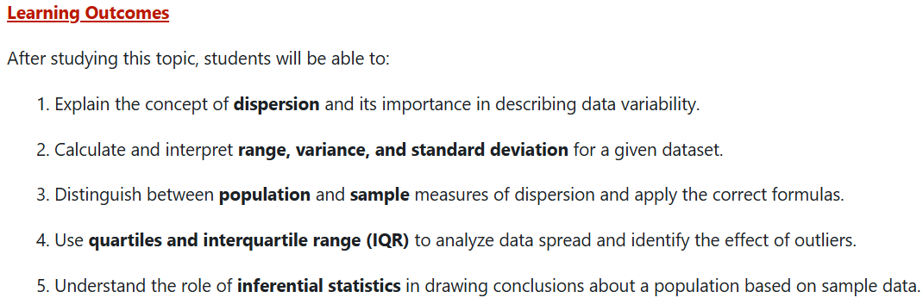

Slide 4
Contents
Standard Deviation
Variance
Range
Quartiles
Inferential Statistics

Slide 5
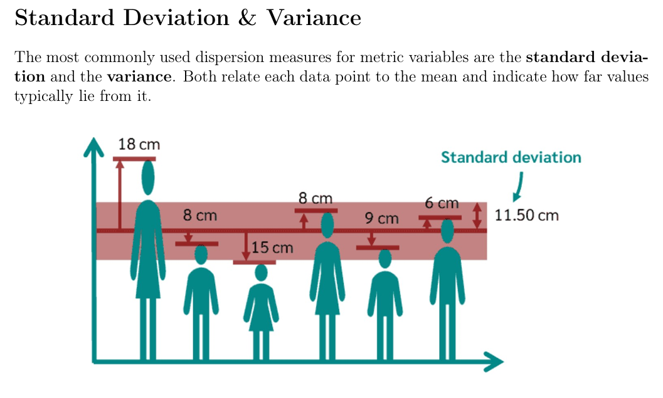
5

Slide 6
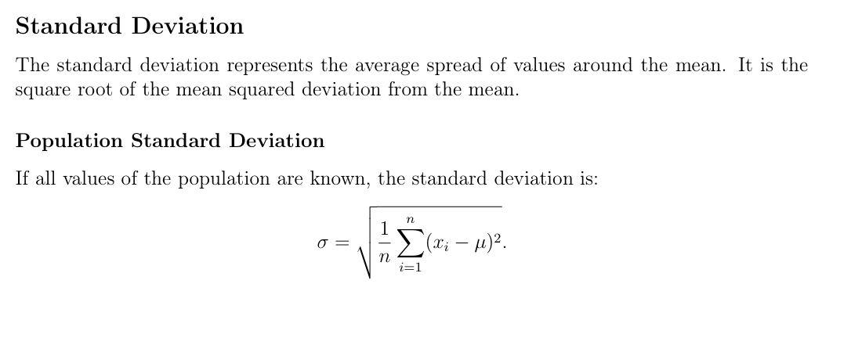

Slide 7
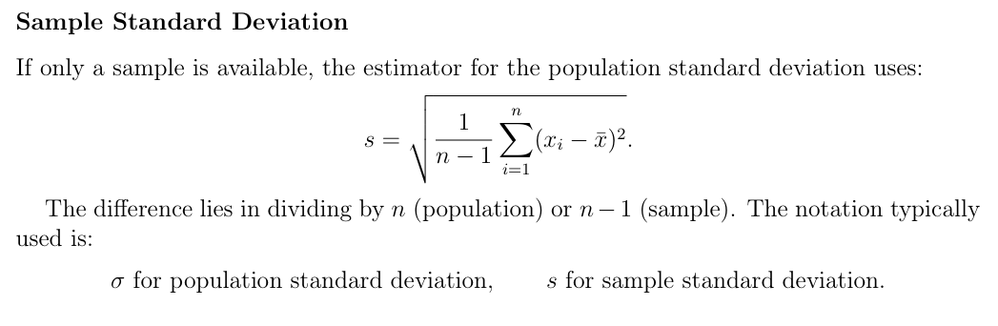
7
Notes:
Background source: PCA (1992).

Slide 8
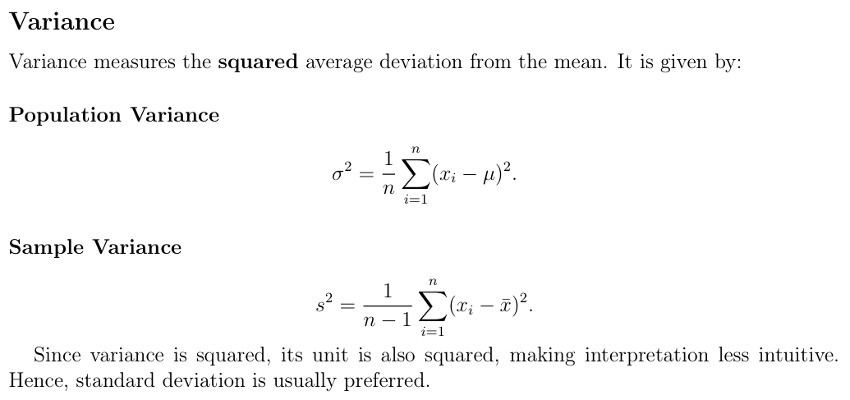

Slide 9
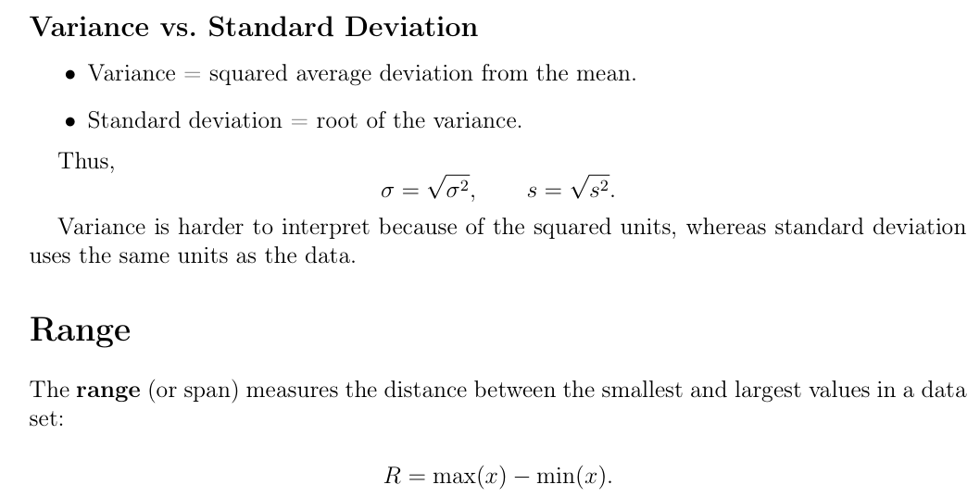

Slide 10
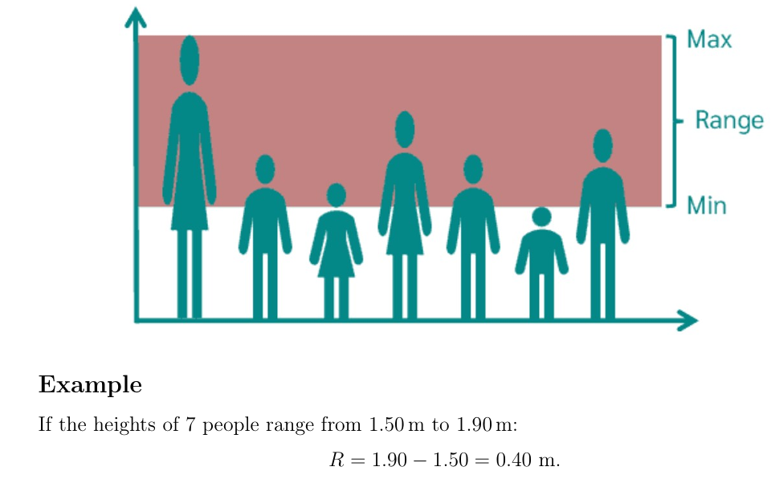
10

Slide 11
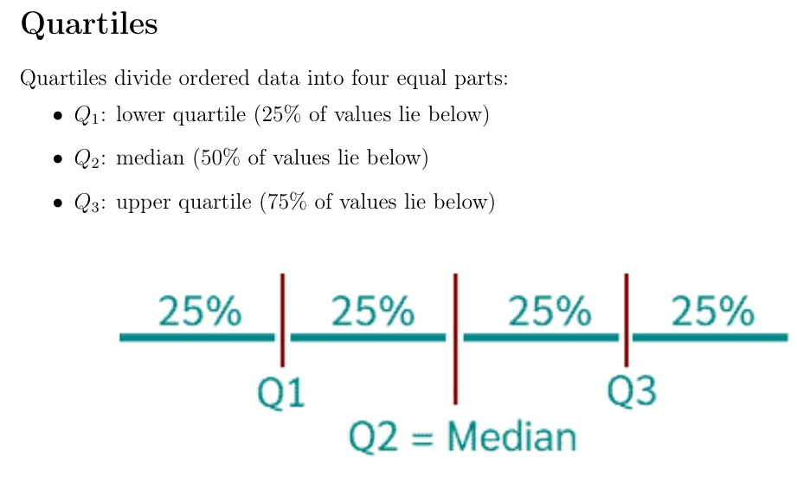

Slide 12
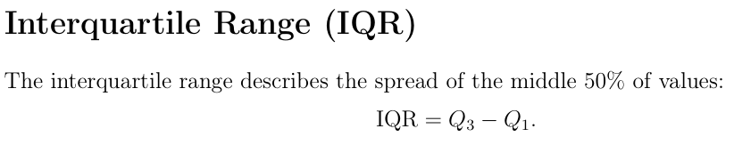
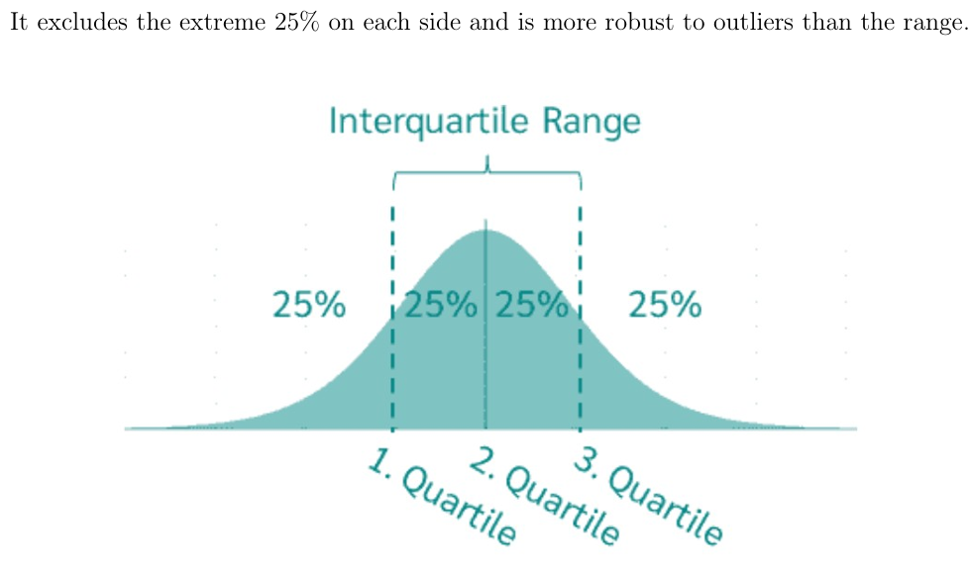
12
Notes:
Background source: PCA (1992).

Slide 13
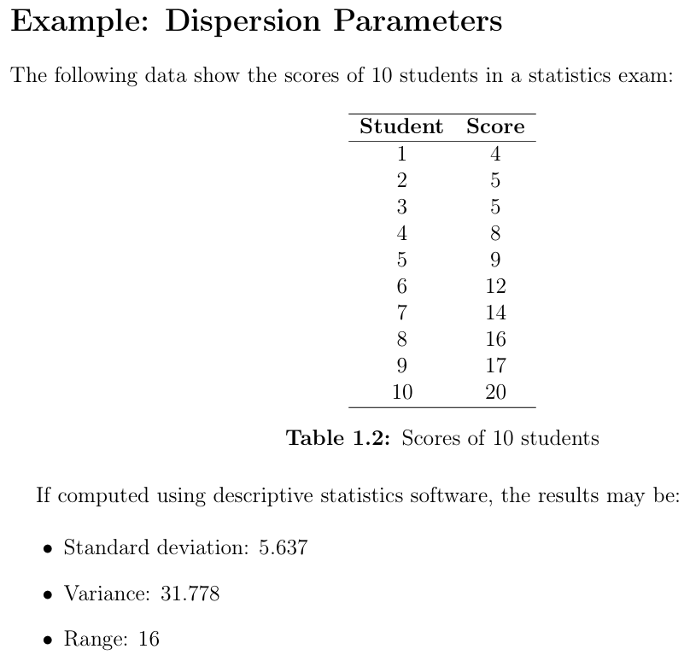

Slide 14
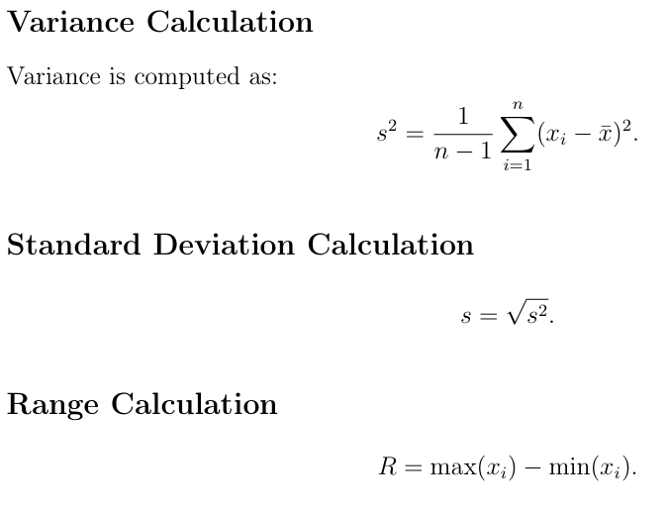

Slide 15
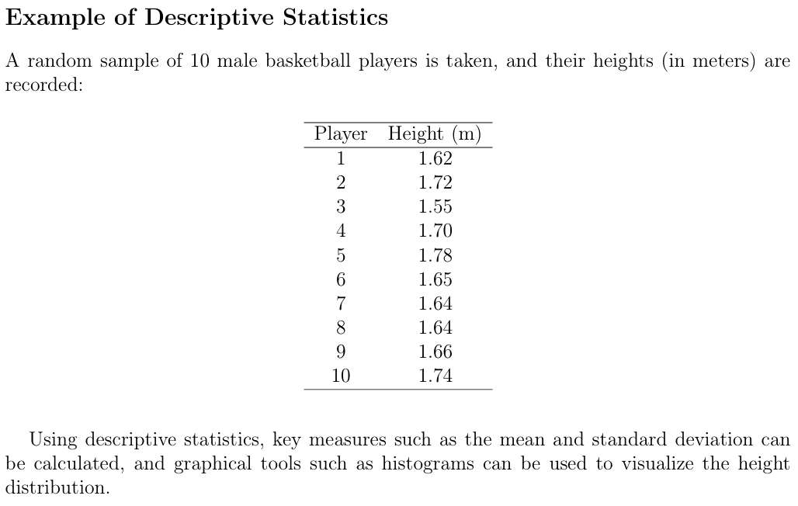

Slide 16
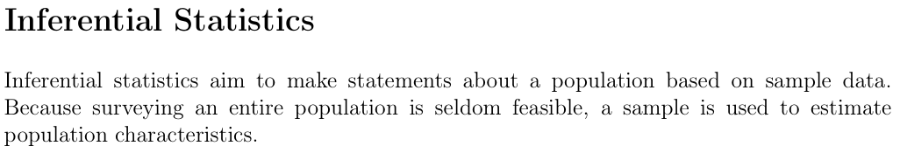
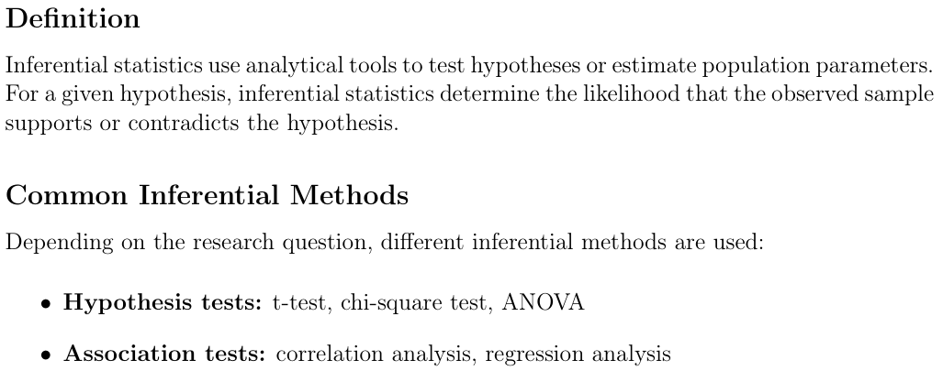

Slide 17
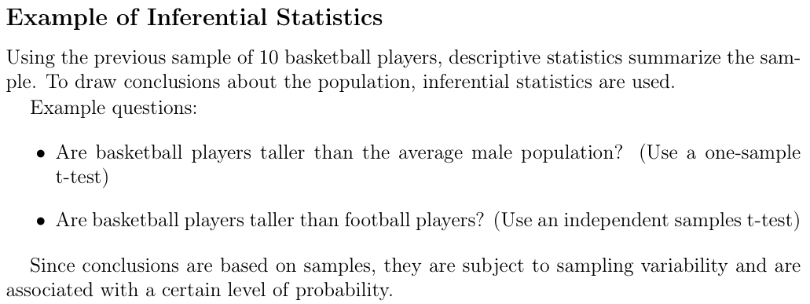

Slide 18
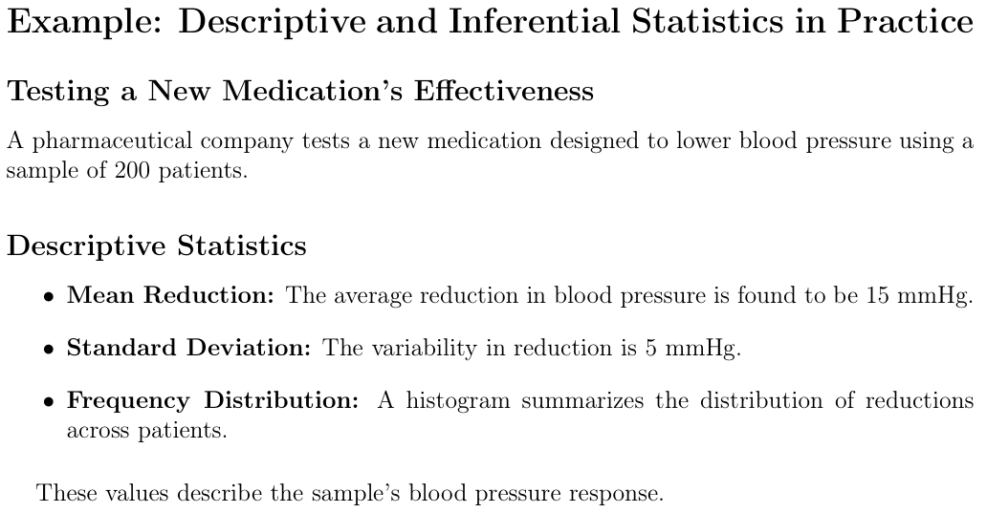
18

Slide 19
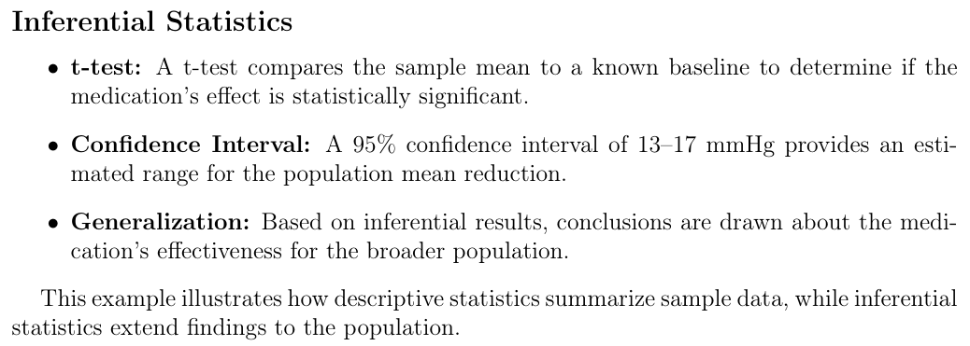

Slide 20
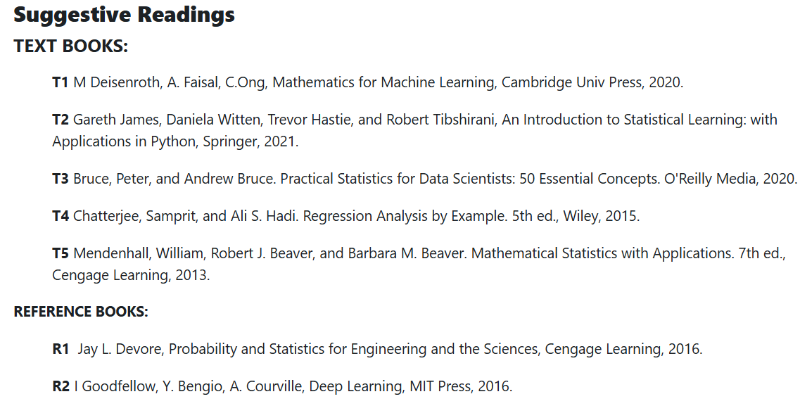
References

Slide 21
Online Video Link-
https://nptel.ac.in/courses/111/105/111105090/
https://www.youtube.com/watch?v=RYIb1u3C13I
https://www.youtube.com/watch?v=S_Zx-g8FU0w&list=PL6C92B335BD4238AB&index=18

Slide 22
THANK YOU
For queries
Email: neetu.e17077@cumail.in

